Slide 1
Pattern Theory
Presentation By Sahar Pirmoradian
Adapted from Ulf Grenander, Brown University

Slide 2
Pattern Theory
Not Pattern Recognition
  Not just classifying objects
A mathematical formalism, A pattern Algebra
  reconstructing the processes and events that produced real structures
  The genesis of the observation = Transformation of some ideal images using various transformations

Slide 3
Generators
Building blocks
  Generating observed signal
  Denoted by g
Generator Space: G
  The set of all generators

Slide 4

Similarity Group
To represent symmetries and invariance of patterns:
  Similarity Group S (Group of Transformations)
    s: elements of this group
    s is a bijective mapping:
    g₁ and g₂ are similar IF there exists a similarity s such that g₂ = sg₁

Slide 5
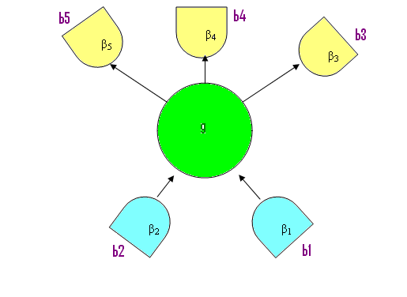
Bonds
  To build larger structures:
    Generators’ interfaces: Bonds (b)
      In the example: b1, b2, b3, b4, b5

Slide 6
Bonds
  Arity (ω(g)), the number of bonds of generator g
    In the example: ω (g)= 5
    ω_{in} (g) = 2
    ω_{out} (g) = 3

Slide 7
Bonds
  bond value (β):
    Assigned to each bond
    In the example:{β₁, β₂, β₃, β₄, β₅}
    IMPORTANT IN COMBINATION OF GENERATORS

Slide 8
Bonds
  Bond Structure is S-invariant:
    If g₁ and g₂ are similar => they have the same bond structure
  Bond Value is not S-invariant.

Slide 9
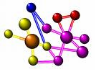
Configurations
Generators ~ Atoms
Configurations ~ Molecules

Slide 10
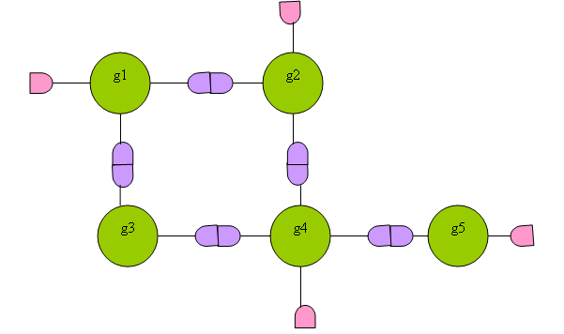
Configuration Diagram
Configuration c = σ(g₁, … g₅)
Internal bonds: connected bonds
External bonds

Slide 11
Bond Value Relation
In a connector graph σ
  ρ : Bond value relation
    ρ:B_{v} X B_{v} -> {True, False}
      B_{v}: set of bond values
    IF ρ (β_{i}, β_{j})= True => Pair (β_{i}, β_{j}) is REGULAR.
    IF ρ (β_{i}, β_{j})=False => Pair (β_{i}, β_{j}) is IRREGULAR.

Slide 12
Connection Type
Connection type: Σ
  The family of connector graphs σ(g₁, … g_{n})
    Σ = LINEAR
    Σ = TREE
    Σ = LATTICE

Slide 13

Regularity
A Configuration c is:
  Locally regular
    If all ρ of internal bonds are true
  Globally regular
If c is both Locally & Globally regular
  => c is Regular

Slide 14
Configuration Space
C(R): configuration space
  The set of all Regular Configurations
  Where R=<G, S, ρ, Σ >
  Referred to as a Regularity

Slide 15
Probabilities
ρ is binary
We should define:
  A continuum valued function
    Acceptor Function,
    A(.,.) on B x B, non-negative real value
  Q(.), non-negative weight function
    Making probabilities depend on generators themselves
  Z: partition function

Slide 16
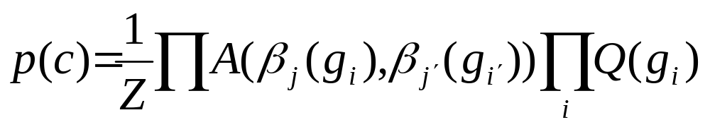
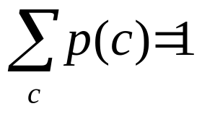
Probability
The probability of configuration c with the connector graph σ(g₁, … g_{n})

Slide 17
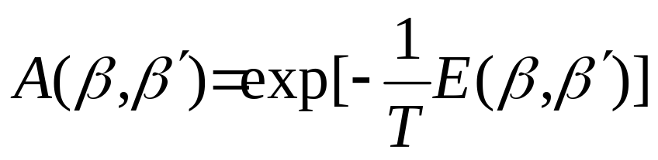
Energy
E: interaction energy
T: temperature, positive constant

Slide 18
Patterns of Thought
An application of Pattern Theory

Slide 19
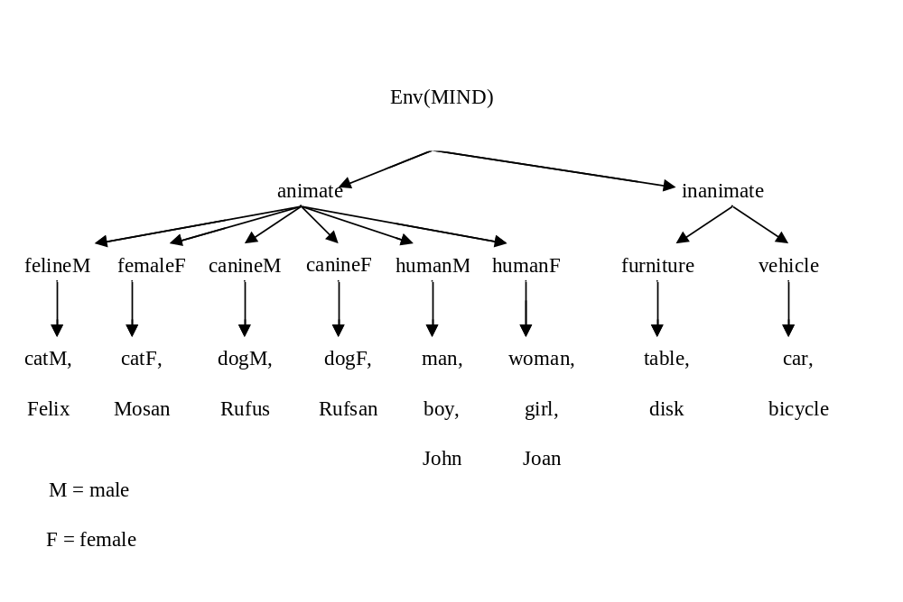
Patterns of Thought
Generators: physical things, non-physical things, events

Slide 20
Modality
G is partitioned into subsets:
  Modalities
  Color, Movement, …

Slide 21
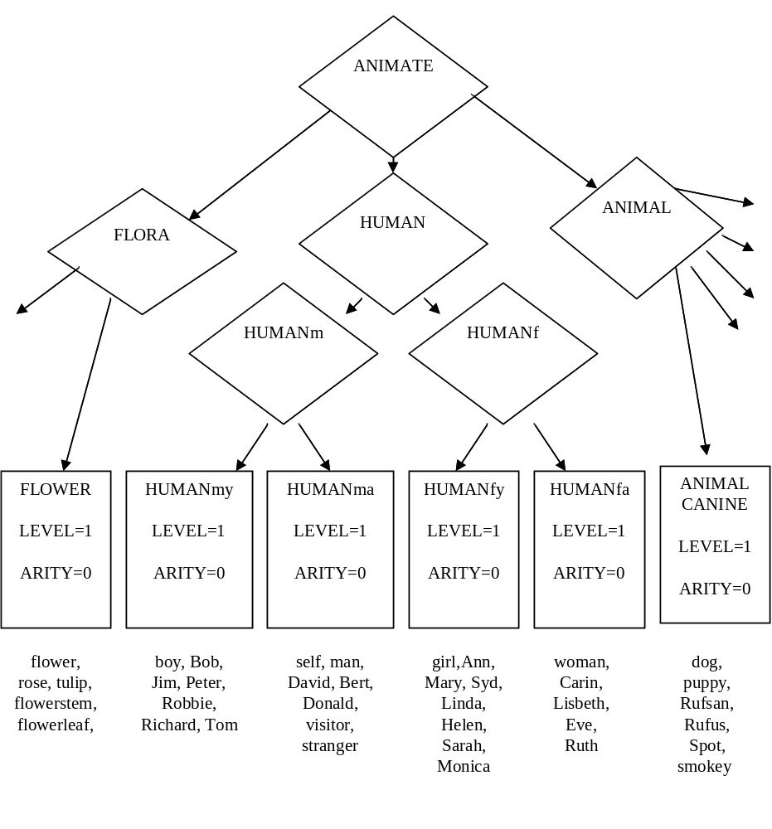
Modality

Slide 22
Thought
Configurations: Thoughts
  Regular thoughts
  Completely regular thoughts
MIND(R): The set of all (completely) regular thoughts

Slide 23
Modality Group
Similarity Group:
  Modality Group
  Generators in a same modality are similar
  Generators can be substituted

Slide 24

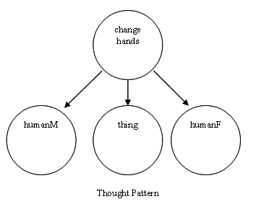
Thought Pattern
A subset is called a thought pattern if it is invariant with respect to the modality group S

Slide 25
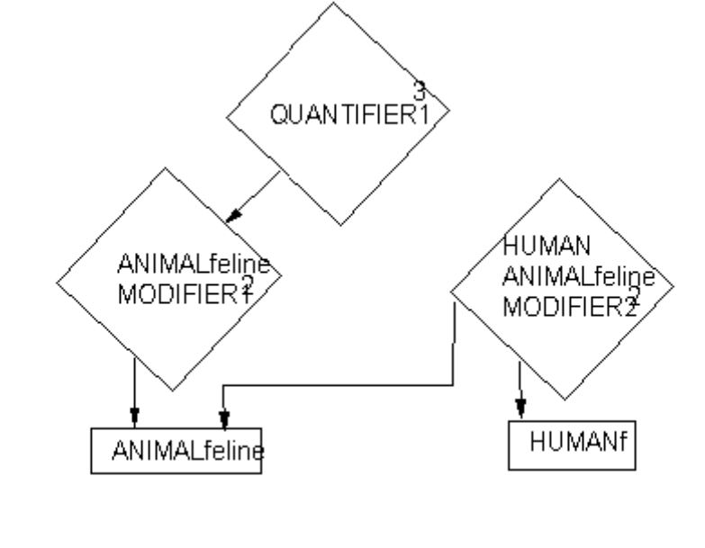
Thought Pattern
Example:
  Mary strokes the very happy cat

Slide 26
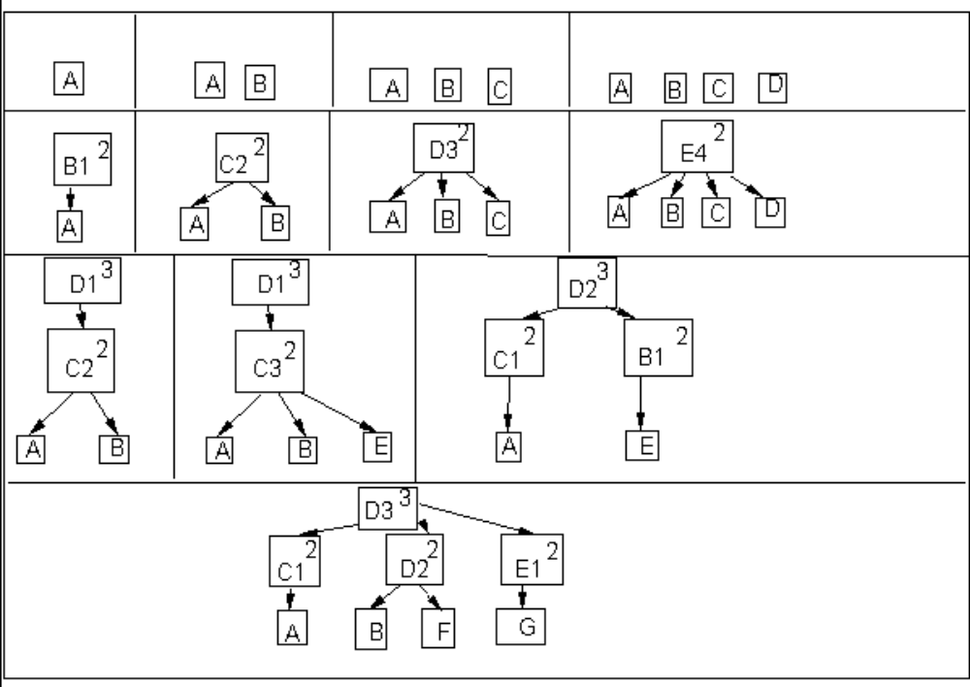
Thought Pattern
Different Topologies of Thought Patterns

Slide 27
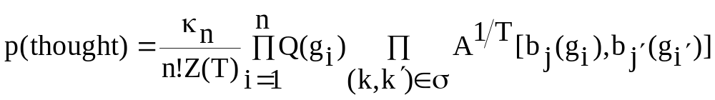
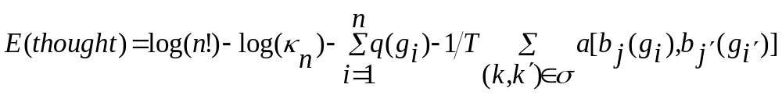
Probabilities of Thought
Energy
  Conscious thoughts, unconscious thoughts

Slide 28
Mental Dynamics
Simple Moves:
  Add a new generator
  Delete a generator and its connections
  Delete a connection
  Create a connection
  Replace a generator by another generator

Slide 29
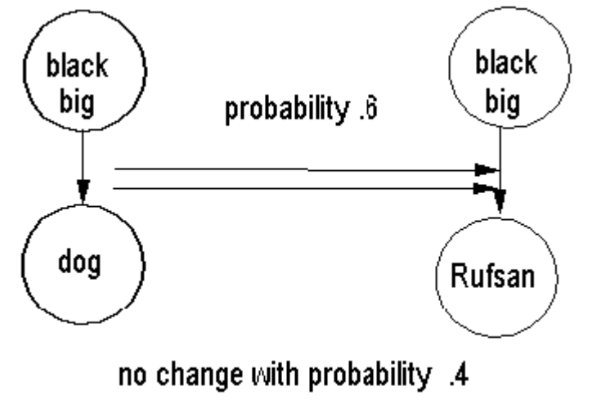
Mental Dynamics
Replace

Slide 30
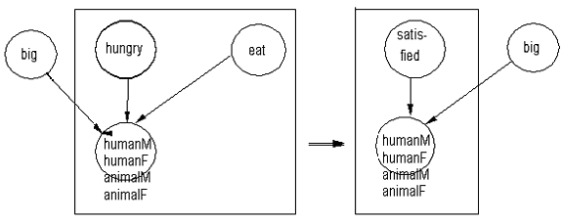
Composite Moves
Delete + Replace

Slide 31
ABSTRACTION
  If a thought occurs more than occasionally:
thought = (married ↓humanM and humanF)
g = marriage

Slide 32
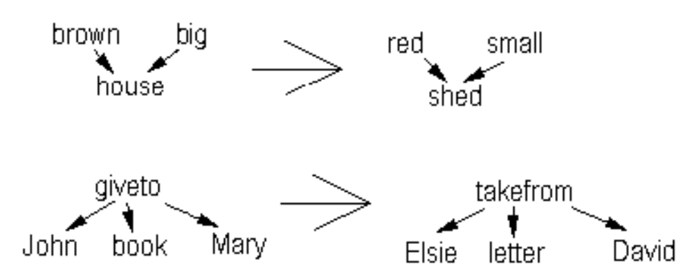
SIMILARITY

Slide 33
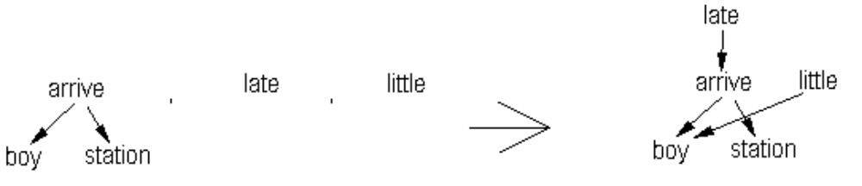
COMPOSITION

Slide 34
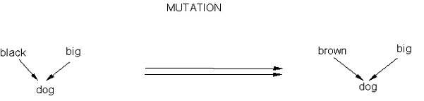
MUTATION

Slide 35
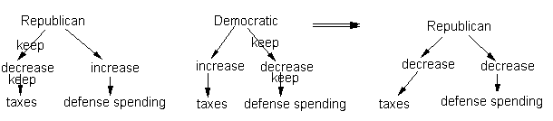
CROSSOVER

Slide 36
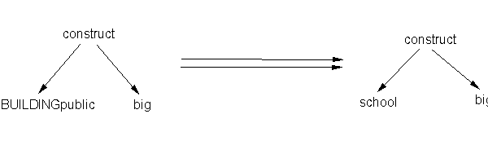
SPECIALAZION

Slide 37

Generalization
  MOD(bark↓Rufus) = (animal_sound↓animalM)

Slide 38
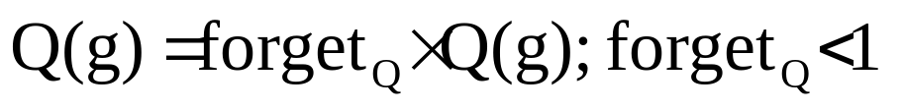
Mind Development (memory)

Slide 39
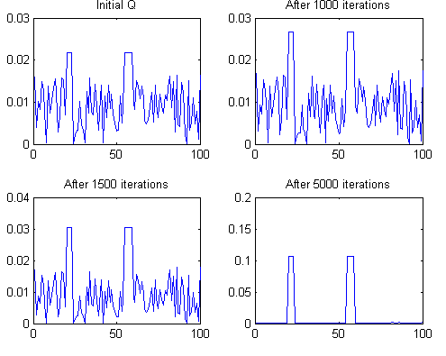
Living alone
Without any Input

Slide 40
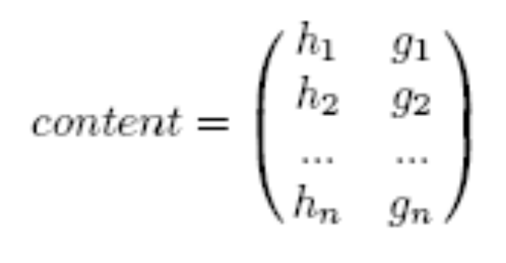
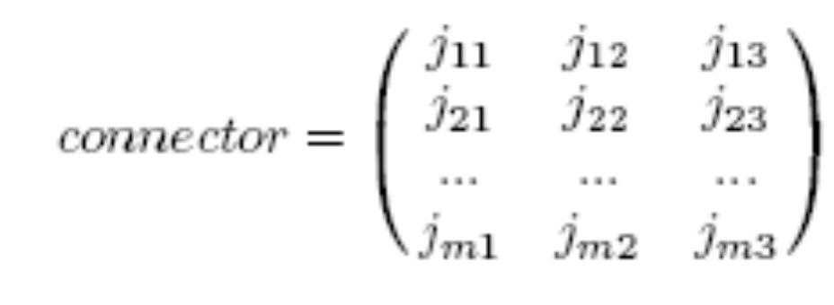
Data Structure

Slide 41
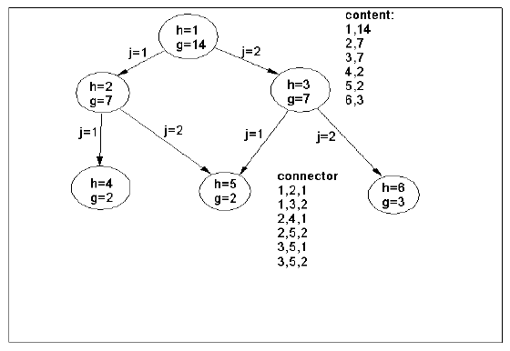

Slide 42
Themes of a person suffering from schizotypal personality disorder:
Ideas of reference Magical thinking Unusual perceptual experience Eccentric behavior | Odd speech Paranoid ideation No close friend Constricted affect Social anxiety

Slide 43
Flow chart
start
thinking1
Time?
Changing
Theme
thinking2
Remembrance
thinking3
yes
no
end

Slide 44
Thinking1
Think3.m
Add generators in L3
Show conscious thought
Save top_3_ideas and top_2_ideas
Update memory
Show idea

Slide 45
Thinking2
Composite moves (composite_moves1.m)
Connect open down bonds
Add generators in L3
Show conscious thought
Save top_3_ideas and top_2_ideas
Update memory
Show idea

Slide 46
Thinking3
Composite moves (composite_moves2.m)
Connect open down bonds
Add generators in L3
Show conscious thought
Save top_3_ideas and top_2_ideas
Update memory
Show idea

Slide 47
Think3
Think3.m
  Content = build_thought_2.m
  Add_generator_new.m
  connecting down bonds
    Find_open_down_bond.m
    Connect_down_bond.m

Slide 48
Composite-move1
add_generator_up_Q(content,connector,theme);
add_generator_new(content,connector,Q_theme);
delete_generator_connections_2(content,connector)
add_generator_up_Q(content,connector,theme);
delete_generator_connections_2(content,connector)
delete_generator_connections_2(content,connector)

Slide 49
Composite-move2
delete_generator_connections_2(content,connector);
add_generator_up_Q(content,connector,theme);
add_generator_new(content,connector,Q_theme);
add_generator_up_Q(content,connector,theme);
add_generator_up_Q(content,connector,theme);
delete_generator_connections_2(content,connector);
delete_generator_connections_2(content,connector);
add_generator_up_Q(content,connector,theme);
delete_generator_connections_2(content,connector);

Slide 50
Build_thought_2
build_thought_2.m:
    Select a random theme
    Select related modalities to the theme
    Select related generators to the modalities
    Set Q(g) = 20 else Q=1
    Selecting generators in different levels:
      With a high probability just one of generators in level 1 is selected.
      More than one, with same probability are selected
      Probability of generators in level4 is zero!
    Content =
1 | 626
2 | 26
3 | 433
Backgammon (modality: Plays )
Dance (modality: Move)
Lose (modality: Outcome)

Slide 51
Add_generator_new
Add_generator_new.m
  Select a generator regarding Q
  Probability of adding the selected generator g: (mu=2)
    P = mu/(n+1) * Q(g)
    P = p / (p+1)
    If select (p, 1-p) == 1 then add g to content

Slide 52
Find_open_down_bond
Find_open_down_bond.m
  Returning found = 1 if there’s still a generator not connected
  Returning the unconnected generator

Slide 53
Connect_down_bond
Connect_down_bond.m:
  Find all of generators may be connected to the unconnected generator
    Finding the modality of the g
    Finding the acceptable modalities for down bond connection of the g
    Finding all the generators of the acceptable modalities
    Search the acceptable generators in the mind

Slide 54
Connect_down_bond
Connect_down_bond.m:
    Probability of selection for connecting to down bond:
      Select(prob1, prob2, ...)
      Prob_i=Q(v(nu))*n/(n+1)*A(g,v(nu))^(1/T)
      T=1
      g: the open down bond generator
      v(nu): acceptable generators in the mind (in the lower level of g)

Slide 55
Connect_down_bond
Connect_down_bond.m
  If not valid generator in mind or already a connector between the generator and the selected generator, a valid generator is connected to the content with probability:
      Prob_i=Q(v(nu))*n/(n+1)*A(g,v(nu))^(1/T)
  in adding a related generator to the mind there's not any condition.
    the mind can think 'bert buy bert ring'.

Slide 56
Get_top_2ideas
Get_top_2ideas.m
  Finding top generators in level 2
  Finding the downward connectors from the top to find the connected generators in level 1
  Comparing omega of the top and the number of connected generators to it

Slide 57
Add_generator_up_Q
Add_generator_up_Q:
  Selecting randomly one of generators in content
  Finding valid generators to be connected upward to the selected generator, regardless of mind
  Computing the probability of each valid generator based on their Qs and As.
  Connecting two selected generators with each other on the valid omega.

Slide 58
Delete_generator_connection_2
Delete_generator_connection_2:
  If connector is empty, delete first member of content with the probability: (mu = 2)
    g = content(1,2)
    prob_del=(n/mu)/Q(g); %check this!
    prob_del=prob_del/(1+prob_del);
    if select([prob_del,1-prob_del]), delete, end
  All the downward and upward connections from the content(1,2) will be found

Slide 59
Delete_generator_connection_2:
  The generator and all the connected generators -gk- be deleted with the probability:
    p=n/(mu*Q(g)) * multiply(A(g,gk)^(-1/T))
    p = p/p+1
    Select(p,1-p)
    A is greater -> the probability of delete is more less

Slide 60
Appendix

Slide 61
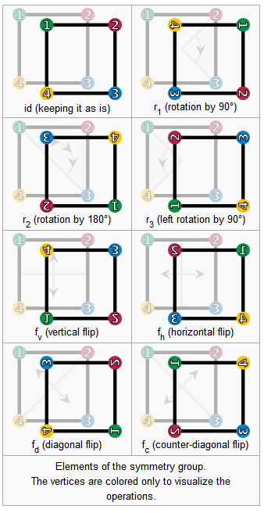
Symmetry Group
Symmetry =
  Rotation & Reflection
Elements:
  id, r1, r2, r3, fv, fh, fd, fc

Slide 62
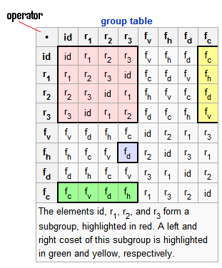
Symmetry Group
Closure
Associativity
Identity Element
Inverse Element

Slide 63
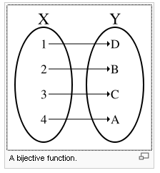
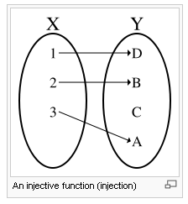
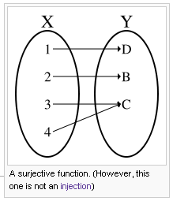
Bijective Function
bijective function is a function f from a set X to a set Y with the property that, for every y in Y, there is exactly one x in X such that
f(x) = y.

Slide 64
Permutation Group
permutation group is a group G whose elements are permutations of a given set M, and whose group operation is the composition of permutations in G (which are thought of as bijective functions from the set M to itself);

Slide 65
Permutation Group- Sample
e = (1)(2)(3)(4)
This is the identity, the trivial permutation which fixes each element.
a = (1 2)(3)(4) = (1 2)
This permutation interchanges 1 and 2, and fixes 3 and 4.
b = (1)(2)(3 4) = (3 4)
Like the previous one, but exchanging 3 and 4, and fixing the others.
ab = (1 2)(3 4)
This permutation, which is the composition of the previous two, exchanges simultaneously 1 with 2, and 3 with 4.

Slide 66
Permutation Group
the relationship is often written as (G,M). Note that the group of all permutations of a set is the symmetric group; the term permutation group is usually restricted to mean a subgroup of the symmetric group. The symmetric group of n elements is denoted by Sn.

Slide 67
Euclidean Space
A Sample of Euclidean Space:
  the sum of the angles in a triangle is always 180 degrees.
The surface of a sphere is not a Euclidean Space:
  The sum of the angles of a triangle on a sphere is greater than 180.

Slide 68
Euclidean Space
There is only one Euclidean space of each dimension.
While there are many non-Euclidean spaces of each dimension.

